Slide 1
Fake Review Classification and Topic Modeling
BY
MATHESH M

Slide 2
AGENDA
Introduction
Problem Statement
Business Use Cases
Approach Overview
Preprocessing
MACHINE LEARNING MODELS
DEEP LEARNING MODELS
Transformer pre trained model
Topic Modelling
Clustering
Results
Conclusion

Slide 3
Introduction
The project aims to address the increasing challenge of fake reviews in the e-commerce space by developing robust systems to:
Detect and classify reviews as fake or genuine.
Group reviews into meaningful clusters to identify patterns.
Extract key topics to derive actionable business insights.
Domain: E-Commerce & NLP
The project lies at the intersection of E-Commerce and Natural Language Processing (NLP), leveraging advanced machine learning and NLP techniques to analyze review text.

Slide 4
Problem Statement
Challenge:
Fake reviews have become a significant challenge in the e-commerce landscape, impacting both consumers and businesses. Key challenges include:
Consumer Trust: Fake reviews mislead customers, causing them to make poor purchasing decisions and diminishing their trust in the platform.
Business Credibility: E-commerce platforms and sellers lose credibility when fake reviews dominate their product listings.
Revenue Impact: Misleading reviews can result in higher returns, customer dissatisfaction, and loss of potential sales.
Need:
There is an urgent need to develop a system that can:
Identify Fake Reviews: Automatically detect and classify reviews as fake or genuine.
Address Misinformation: Filter out misleading content to ensure authenticity in product feedback.
Extract Actionable Insights: Derive meaningful insights from genuine reviews to enhance product quality, customer satisfaction, and business strategies

Slide 5
Business Use Cases
Customer Trust: Detect and Filter Out Fake Reviews
Fake reviews can mislead buyers and damage a platform's reputation. This system enhances trust by identifying and filtering fake reviews, ensuring that only authentic feedback influences consumer decisions.
Product Feedback Analysis: Identify Common Issues and Highlights
Product Feedback Analysis: Identify Common Issues and Highlights
By analyzing genuine reviews, businesses can extract valuable insights regarding:
Common Issues: Identify recurring problems such as product defects, delivery delays, or usability challenges.
Highlights: Understand the most appreciated features, like quality, price, or performance.
Content Moderation: Automate Harmful Review Detection
Automating the detection of fake or harmful reviews reduces manual effort and ensures a clean review ecosystem.
Removes spam and offensive content that could deter genuine customers.
Flags reviews that may violate community guidelines

Slide 6
Approach Overview
DATA PREPROCESSING
MACHINE LEARNING MODELS ANALYSIS
DEEP LEARNING MODEL ANALYSIS
TRANSFORMERS –PRE TRAINED MODEL
TOPIC MODELLING
CLUSTERING

Slide 7
DATA PREPROCESSING
Data Cleaning
Tokenization
Stop-word Removal
Stemming or Lemmetization
Feature Extraction
Split the Dataset
Remove Special Characters, Numbers, and Stopword.
Clean the review text by eliminating irrelevant characters and common words (e.g., "the", "is") that don’t contribute to meaning
Tokenize and Lemmatize Text.
Break text into individual words or phrases (tokens)
Convert words to their root forms (e.g., "running" → "run") to ensure consistency
Convert to Numerical Vectors.
Transform the processed text into a numerical format using techniques like
TF-IDF (Term Frequency-Inverse Document Frequency): Highlights important words in the review
Word2Vec: Captures semantic relationships between words

Slide 8
ML MODELS
DL MODELS
Logistic Regression
Decision Tree model
Random Forest Classifier
SVM
Naive Bayes
RNN Model
LSTM Model
Bi LSTM Model

Slide 9
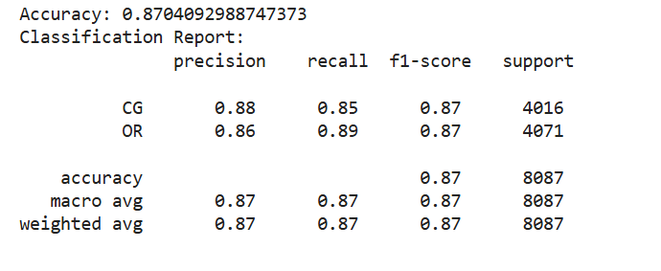
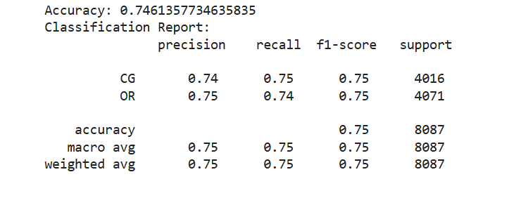
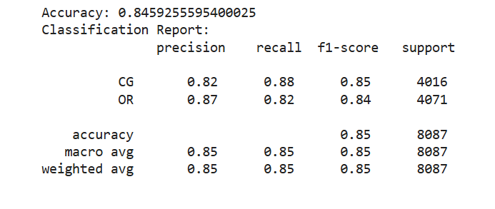
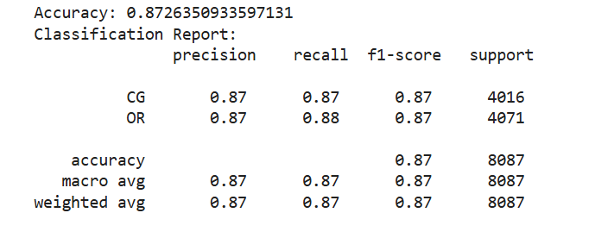

Logistic Regression
Decision Tree model
ML MODELS
Random Forest Classifier
SVM
Naive Bayes

Slide 10
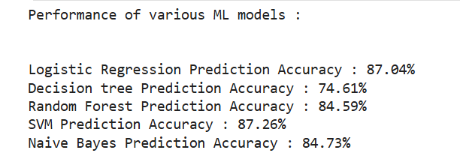
OVERALL PERFORMANCE

Slide 11
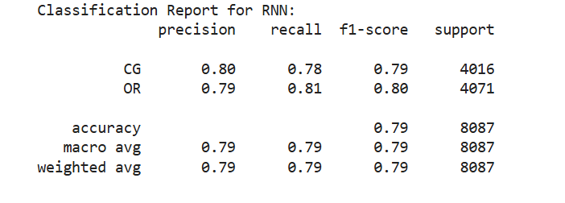
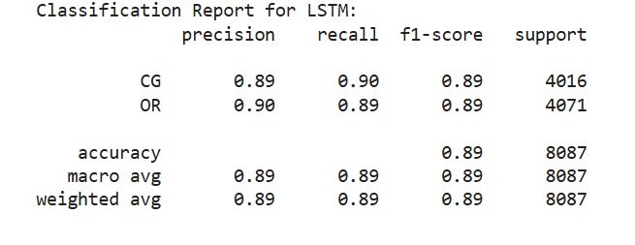
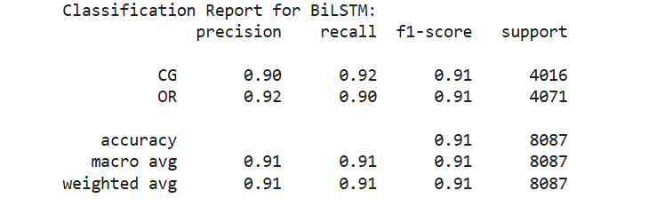
RNN Model
LSTM Model
DL MODELS
Bi LSTM Model

Slide 12
TRANSFORMERS
Data Preparation.
The input data contained reviews labeled as either CG OR OR. These were encoded into binary labels and Split the dataset into training and testing sets (80%-20%)
Data Preprocessing:
Converted text data into tokenized and numerical forms using the DistilBERT tokenizer.
Applied truncation and padding to ensure consistent sequence lengths
Model Selection
Used the pre-trained model DistilBERT (distilbert-base-uncased), fine-tuned for binary classification with two labels
Training Setup
Configured training parameters such as batch size, learning rate, and number of epochs
Implemented the Hugging Face Trainer API for model training and evaluation
Evaluation Metrics.
Evaluated the model using accuracy and a classification report (precision, recall, and F1-score for each class)
Generated detailed metrics for performance comparison across epochs

Slide 13
Results Analysis
Epoch 1
Epoch 2
Epoch 3
Accuracy: 92.20%
F1-scores
CG:92.41 %
OR:91.97 %
Accuracy: 93.03%
F1-scores
CG: 93.10 %
OR: 92.95 %
Accuracy: 90.82%
F1-scores
CG :91.11%
OR :90.52%
Final Test Results…..
Accuracy: 93.03%.
Detailed classification report showed balanced performance across both labels, with high precision and recall values

Slide 14
Topic Modelling
Data Preparation.
The process began with data preparation, where the dataset containing textual reviews was loaded. The text was cleaned and preprocessed to ensure consistency. This involved converting all text to lowercase, removing punctuation and special characters, and eliminating stopwords using NLTK’s stopword list. These steps ensured that only meaningful words were retained, preparing the data for further analysis
Feature Extraction
After preprocessing, the text data was transformed into numerical representations using two vectorization techniques. The TF-IDF Vectorizer captured the importance of each word relative to a document, while the Count Vectorizer represented word frequency across the entire text corpus. These vectorized formats formed the foundation for applying machine learning models to identify latent topics.
Model Training
Two models were used to uncover the hidden topics in the data. The Latent Dirichlet Allocation (LDA) model identified topics by analyzing the probabilistic distribution of words within documents, making it effective in representing document-topic relationships. On the other hand, Non-Negative Matrix Factorization (NMF) utilized matrix decomposition to identify topics, focusing on directly uncovering relationships between words and topics. Both methods trained with 50 topics to ensure comprehensive coverage of the dataset's themes.

Slide 15
Topic Modelling
Topic Display Data Preparation.
The trained models produced topics characterized by the most relevant keywords. These keywords provided a clear summary of the identified topics. By examining the top words, the topics' essence was interpreted, helping to categorize the text data effectively. This process enabled a better understanding of the patterns and themes present in the dataset.
Visualization.
To enhance interpretability, WordClouds were generated for each topic. These visualizations showcased the most prominent words in each topic, making it easier to grasp the thematic significance. Separate WordClouds were created for both LDA and NMF topics, offering a side-by-side comparison of the two approaches. These visuals made the results more accessible and engaging for stakeholders

Slide 16
Overview of K-Means Clustering
K-Means clustering is an unsupervised learning algorithm used to partition data into a predefined number of groups, or clusters, based on similarity. The goal is to group similar data points together, minimizing the intra-cluster distance and maximizing the inter-cluster distance. In this analysis, K-Means was applied to the preprocessed textual data to identify thematic groupings or patterns within the reviews.
Number of Clusters
Clustering with K-Means
Adding Cluster Labels
Cluster Insights
The combination of topic modeling and clustering creates a comprehensive understanding of unstructured textual data, providing both granular themes and broader group-level patterns.

Slide 17
Cluster 1: Book Reviews
Reviews talk about books and stories
Discussion about the writing quality, characters, and plot development.
Some reviews compare books within a series or provide recommendations
Cluster 2: Pet Products
Reviews center around dog-related products like harnesses, treats, and litter boxes.
Feedback about product size, fit, and usability is common.
Cluster 3: Clothing and Accessories
Reviews for clothing, hats, and accessories
Positive sentiment about fit, colors, and gift potential.
Cluster 4: Movie and Entertainment
Reviews about movies and TV shows
Mention of acting quality, plot predictability, and personal preferences (e.g., liking or disliking certain genres)

Slide 18
CONCLUSION
The analysis successfully applied machine learning techniques, including K-Means clustering and topic modeling, to uncover valuable insights from the textual data. By clustering reviews into distinct groups, we identified unique patterns and themes that highlight customer sentiments, preferences, and concerns. Additionally, advanced models like Latent Dirichlet Allocation (LDA) and Non-Negative Matrix Factorization (NMF) were employed for topic modeling, providing a deeper understanding of the prevalent topics in the dataset.
These models not only revealed actionable insights but also demonstrated the effectiveness of machine learning in processing and interpreting large volumes of unstructured text data. By combining clustering and topic modeling, the analysis provided a comprehensive view of the data, enabling data-driven decision-making and targeted strategies for improving business outcomes

Slide 19
THANK YOU

